Slide 1
Intelligent Agents
Lecture# 2

Slide 2
Outline
Agents and environments
Rationality
PEAS (Performance measure, Environment, Actuators, Sensors)
Environment types
Agent types

Slide 3
Agents
An agent is anything that can be viewed as perceiving its environment through sensors and acting upon that environment through actuators.
  Human agent: eyes, ears, and other organs for sensors; hands, legs, mouth, and other body parts for actuators
  Robotic agent: cameras and infrared range finders for sensors; various motors for actuators
  A software agent: receives keystrokes, file contents, and network packets as sensory inputs and acts on the environment by displaying on the screen, writing files, and sending network packets.

Slide 4

Agents and environments

Slide 5
Structure of Agents
Agent = architecture + program
architecture
  device with sensors and actuators
  e.g., A robotic car, a camera, a PC, …
program
  implements the agent function on the architecture

Slide 6

Simple Terms
Percept
  Agent’s perceptual inputs at any given instant
Percept sequence
  Complete history of everything that the agent has ever perceived.

Slide 7
Agent Function
a = F(p)
  where p is the current percept, a is the action carried out, and F is the agent function
F maps percepts to actions
F: P → A
  where P is the set of all percepts, and A is the set of all actions
In general, an action may depend on all percepts observed so far, not just the current percept, so…

Slide 8
Agent Function Refined
a_{k} = F(p₀ p₁ p₂ …p_{k})
  where p₀ p₁ p₂ …p_{k} is the sequence of percepts observed to date, a_{k} is the resulting action carried out
F now maps percept sequences to actions
  F: P* → A

Slide 9

Vacuum-cleaner world
Percepts: location and contents, e.g., [A,Dirty]
Actions: Left, Right, Suck, NoOp

Slide 10

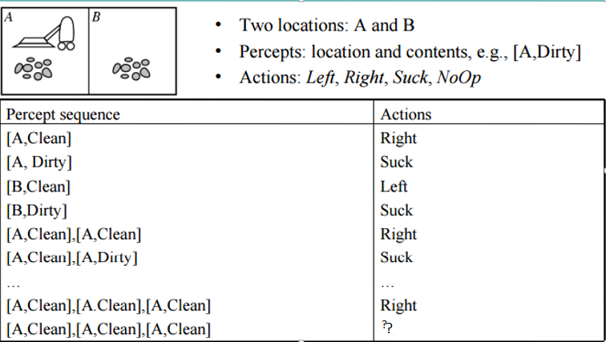
Vacuum-cleaner world

Slide 11
Rational agents
Rational Agent: For each possible percept sequence:
a rational agent should select an action that is expected to maximize its performance measure, given the evidence provided by the percept sequence and whatever built-in knowledge the agent has.
E.g., an exam
  Maximize marks, based on the questions on the paper & your knowledge.

Slide 12
Example of a rational agent
Actions that can perform
  Left, Right, Suck and NoOp
Percept sequences
  Where is the agent?
  Whether the location contains dirt?
Under this circumstance, the agent is rational.

Slide 13
Concept of Rationality
Rational agent
  One that does the right thing
  = every entry in the table for the agent function is correct (rational).
What is correct?
  The actions that cause the agent to be most successful
  So we need ways to measure success.

Slide 14
Performance measure
A general rule:
No universal performance measure for all agents. Design performance measures according to
    What one actually wants in the environment
    Rather than how one thinks the agent should behave
E.g., in vacuum-cleaner world
  We want the floor clean, no matter how the agent behave.
  We don’t restrict how the agent behaves.

Slide 15
Performance measure
E.g., performance measure of a vacuum-cleaner agent could be amount of dirt cleaned up, amount of time taken, amount of electricity consumed, amount of noise generated, etc.

Slide 16
Learning
Does a rational agent depend on only current percept?
  No, the past percept sequence should also be used
  This is called learning
  After experiencing an episode, the agent
    should adjust its behaviors to perform better for the same job next time.

Slide 17
Autonomy
If an agent just relies on the prior knowledge of its designer rather than its own percepts then the agent lacks autonomy
A rational agent should be autonomous- it should learn what it can to compensate for partial or incorrect prior knowledge.
E.g., various software agents, including artificial life agents, and many computer viruses.
  No input (percepts)
  Run only but its own algorithm (prior knowledge)
  No learning, no experience, etc.

Slide 18
Autonomous agent
The agent acts to change part of the environment or of its status and influences what it sensed.
Sometimes, the environment may not be the real world
  E.g., flight simulator, video games, Internet
  They are all artificial but very complex environments
  Those agents working in these environments are called
    Software agent (softbots)
    Because all parts of the agent are software

Slide 19
Generic agent
Agent covers a broad spectrum of machines like:
Thermostats (which do not learn anything new)
Worms (which can actually learn a small collection of behaviors)
Humans (with the greatest learning capacity, so far, on earth).

Slide 20
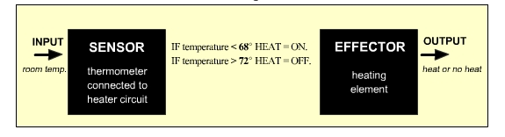
Generic Agent-(Thermostat Agent)
Notice that the thermostat agent responds to a very specific feature of the environment with only three possible actions:
turn heat on or
turn heat off or
take no action.
Such an agent does not really qualify as intelligent or autonomous.

Slide 21
PEAS
PEAS: Performance measure, Environment, Actuators, Sensors.
Must first specify the setting for intelligent agent design.
Consider, e.g., the task of designing an automated taxi driver:
  Performance measure
  Environment
  Actuators
  Sensors

Slide 22
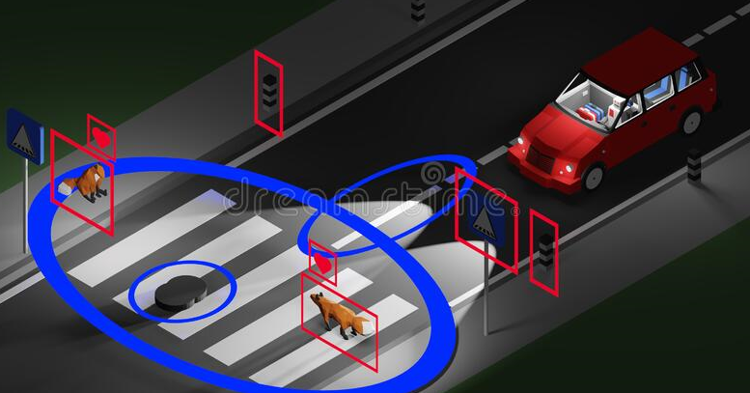
Automated taxi driver

Slide 23
PEAS
Must first specify the setting for intelligent agent design
Consider, e.g., the task of designing an automated taxi driver:
  Performance measure: Safe, fast, legal, comfortable trip, maximize profits.
  Environment: Roads, other traffic, pedestrians, customers.
  Actuators: Steering wheel, accelerator, brake, signal, horn.
  Sensors: Camera, speedometer, GPS, odometer, engine sensors, LCD.

Slide 24
PEAS
Agent: Medical diagnosis system
Performance measure: Healthy patient, minimize costs, lawsuits.
Environment: Patient, hospital, staff
Actuators: Screen display (questions, tests, diagnoses, treatments)
Sensors: Keyboard (entry of symptoms, findings, patient's answers)

Slide 25

Part-picking robot

Slide 26
PEAS
Agent: Part-picking robot
Performance measure: Percentage of parts in correct bins
Environment: Conveyor belt with parts, bins
Actuators: Jointed arm and hand
Sensors: Camera, joint angle sensors

Slide 27

Online tutor

Slide 28
PEAS
Agent: Online tutor
Performance measure: Maximize student's score on test
Environment: Set of students
Actuators: Screen display (exercises, suggestions, corrections)
Sensors: Keyboard, student’s feedback.

Slide 29
Task Environments
Fully observable vs. partially observable
An agent's sensors give it access to the complete state of the environment at each point in time. Then we say that the task environment is fully observable.
An environment might be partially observable because of noisy and inaccurate sensors or because parts of the state are simply missing from the sensor data.
for example: Chess – the board is fully observable. Driving – the environment is partially observable because what’s around the corner is not know.

Slide 30
Task Environments
Deterministic vs. stochastic
An environment is called Deterministic is where your agent’s actions uniquely determine the outcome. For example in Chess, there is no randomness when you move a piece. (If the environment is deterministic except for the actions of other agents, then the environment is strategic).
If the environment is partially observable, however, then it could appear to be stochastic.
An environment is called Stochastic is where your agent’s actions don’t uniquely determine the outcome. For example in games with dice, you can determine your dice throwing action but not the outcome of the dice.

Slide 31
Task Environment
Episodic vs. sequential
The agent's experience is divided into atomic "episodes" (each episode consists of the agent perceiving and then performing a single action), and the choice of action in each episode depends only on the episode itself.
Many classification tasks are episodic. For example, an agent that has to spot defective parts on an assembly line, bases each decision on the current part, regardless of previous decisions; moreover, the current decision doesn’t affect whether the next part is defective.

Slide 32
Cont…
In sequential environments, on the other hand, the current decision could affect all future decisions.
For Example, Chess and taxi driving are sequential in both cases, short-term actions can have long-term consequences.

Slide 33
Environment types
Static (vs. dynamic)
An environment is static if only the actions of an agent modify it. It is dynamic on the other hand if other processes are operating on it.
For Example: Taxi driving is clearly dynamic the other cars and the taxi itself keep moving.
Crossword puzzles are static.

Slide 34
Task Environment
Discrete (vs. continuous)
An environment is said to be discrete if there are a finite number of actions that can be performed within it.
For Example,
Discrete environment: A game of chess or checkers where there are a set number of moves.
Continuous environment: Taxi driving is a continuous-state and continuous-time problem: the speed and location of the taxi and of the other vehicles sweep through a range of continuous values and do so smoothly over time. Taxi-driving actions are also continuous (steering angles, etc.).

Slide 35
Task Environment
Single agent vs. multiagent
The distinction between single-agent and multiagent environments may seem simple enough. For example, an agent solving a crossword puzzle by itself is clearly in a single-agent environment, whereas an agent playing chess is in a two-agent environment.
For example, in chess, the opponent entity B is trying to maximize its performance measure, which, by the rules of chess, minimizes agent A’s performance measure.

Slide 36
Task Environment
Thus, chess is a competitive multiagent environment.
In the taxi-driving environment, on the other hand, avoiding collisions maximizes the performance measure of all agents, so it is a partially cooperative multiagent environment.
It is also partially competitive because, for example, if only one car can occupy a parking space.

Slide 37
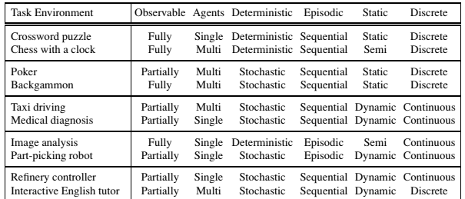
Task Environments & their Characteristics

Slide 38
Agent types
Simple reflex agents
Model-based reflex agents
Goal-based agents
Utility-based agents
Learning agent

Slide 39
Simple Reflex Agent
The Simple reflex agents are the simplest agents. These agents take decisions on the basis of the current percepts and ignore the rest of the percept history.
These agents only succeed in the fully observable environment.
The Simple reflex agent does not consider any part of percepts history during their decision and action process.
The Simple reflex agent works on Condition-action rule, which means it maps the current state to action.
Such as a Room Cleaner agent, it works only if there is dirt in the room.

Slide 40
Simple Reflex Agents
Problems for the simple reflex agent design approach:
  They have very limited intelligence
  They do not have knowledge of non-perceptual parts of the current state
  Not adaptive to changes in the environment

Slide 41
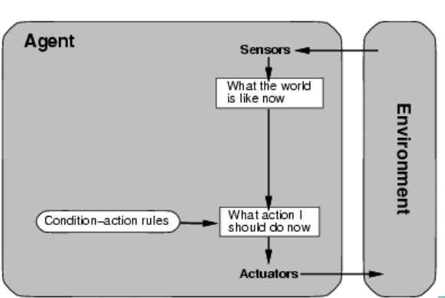

Slide 42
Model-Based Reflex Agent
The Model-based agent can work in a partially observable environment, and track the situation.
A model-based agent has two important factors:
  Model: It is knowledge about "how things happen in the world," so it is called a Model-based agent.
  Internal State: It is a representation of the current state based on percept history.
These agents have the model, "which is knowledge of the world" and based on the model they perform actions.

Slide 43
Model-Based Reflex Agent
Updating the agent state requires information about:
  How the world evolves
  How the agent's action affects the world.
Example:
Autonomous vehicles.

Slide 44
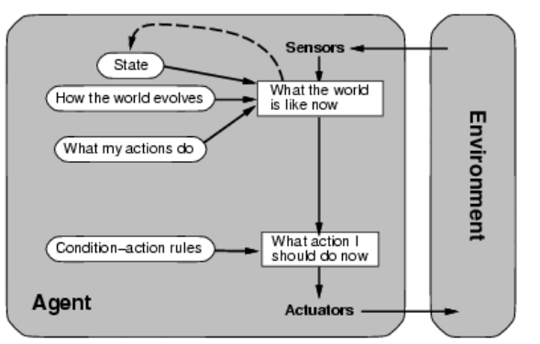

Slide 45
Goal-Based Agent
Actions chosen to reach a desired goal
– Goals help decide which actions are good
– Proactive rather than reactive
– May have to consider long sequences of possible actions before deciding if goal is achieved: “what will happen if I do this…?”
– Based on searching and planning.

Slide 46
Example
Driverless cars are good examples of a goal-based agent when they are programmed with an end destination, or goal, in mind. The car will then '‘plan'' and make the right decisions in order to deliver the passenger where they intended to go.

Slide 47

Goal-based agents

Slide 48
Utility-Based Agent
Choose which alternative is best
Utility function gives a measure of success or goodness for a given state
Utility-based agent act based not only goals but also the best way to achieve the goal.
The Utility-based agent is useful when there are multiple possible alternatives, and an agent has to choose in order to perform the best action.
The utility function maps each state to a real number to check how efficiently each action achieves the goals.

Slide 49
Utility-Based Agent
Agents so far have had a single goal. Agents may have to juggle conflicting goals.
Need to optimize utility over a range of goals. Utility is measure of goodness (a real number).Combine with probability of success to get expected utility.
Example:
Agent: automatic car. Environment: roads, vehicles, signs, etc. – Goals: stay safe, reach destination, be quick, obey law, save fuel, etc.

Slide 50

Utility-based agents

Slide 51
Learning Agents
A learning agent in AI is the type of agent which can learn from its past experiences, or it has learning capabilities.
It starts to act with basic knowledge and then able to act and adapt automatically through learning.
A learning agent has mainly four conceptual components, which are:
  Learning element: It is responsible for making improvements by learning from environment
  Critic: Learning element takes feedback from critic which describes that how well the agent is doing with respect to a fixed performance standard.
  Performance element: It is responsible for selecting external action
  Problem generator: This component is responsible for suggesting actions that will lead to new and informative experiences.

Slide 52
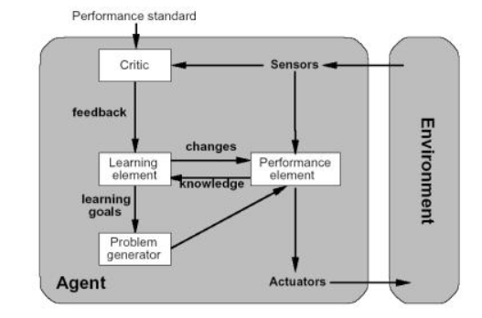
Learning Agents

Slide 53
Points to ponder
Intelligent agent has been around for years, but the actual implementation is still in its early stages.
As agents gain a wider acceptance and become more sophisticated, they will become a major factor in the future of the Internet.
Intelligent agents will not completely replace surfing altogether, but they will make information gathering much easier for the users or consumer.

Slide 54
Task to do
List out at least two examples of each type of agent and submit it in the next class.

